Slide 1
AUTOMATED DETECTION OF WHITE BLOOD CELL CANCER
Category : In-house/Off Campus
Guide:
Prakash R Associate Professor,
School of Electronics Engineering, Vellore Institute of Technology.
Surendar.D
22MTS0002

Slide 2
ABSTRACT:
In this proposed system, we aim to develop an application that helps in the diagnosis of white blood cell diseases, which is an improvement on the existing approach. We tend to show results that are higher than the prevailing system in the performance analysis parameters of detection accuracy and classification.
The proposed system represents a KNN, SVM, RF and CNN algorithm that helps in the diagnosis of white blood cell diseases. We divide these diseases into two categories leukaemia and myeloma. Each category includes similar symptoms and diseases that can be hard to diagnose.
This system is applied to classify two disease categories by calculating different features with the help of GLCM(Gray-Level Co-occurrence Matrix). KNN, SVM, RF and CNN is used to make the final decision. Our project is to detect white blood cell cancer at an early stage, reducing misdiagnosis cases in addition to improving the system's learning methodology.

Slide 3
LITERATURE SURVEY:
TOPIC: | YEAR: | METHODOLOGY: | PROBLEM:
A novel Deep Learning Framework (DLF) for classification of Acute Lymphoblastic Leukemia. | 2022 (springer) | Deep Learning Framework (DLF) | Trained On A Smaller Balanced Dataset.
Exploiting the Multiscale Information Fusion Capabilities for Aiding the Leukemia Diagnosis Through White Blood Cells Segmentation. | 2022 (IEEE) | Multi-scale Information Fusion Network (MIF-NET) | Computational Efficiency Very Low.
Automated Diagnosis of Leukemia. | 2021 (IEEE) | Computer-aided Diagnosis (CAD) | Acquiring Large Datasets.

Slide 4
LITERATURE SURVEY:
TOPIC: | YEAR: | METHODOLOGY: | PROBLEM:
Categorizing white blood cells by utilizing deep features of proposed 4B-AdditionNet-based CNN network with ant colony optimization. | 2021 (springer) | Convolutional Neural Network Model Ant Colony Optimization. | Cannot Deal With Large Amount Data.
A convolutional neural network–based learning approach to acute lymphoblastic leukaemia detection with automated feature extraction. | 2021 (springer) | Convolutional Neural Network Model Acute Lymphoblastic Leukemia Image Database | Not Use Any Pre-processing Or Segmentation Technique.
Automated recognition of white blood cells using deep learning. | 2021 (springer) | Region With Convolutional Neural Network Model | Huge Amount Of Trained Dataset Needed.

Slide 5
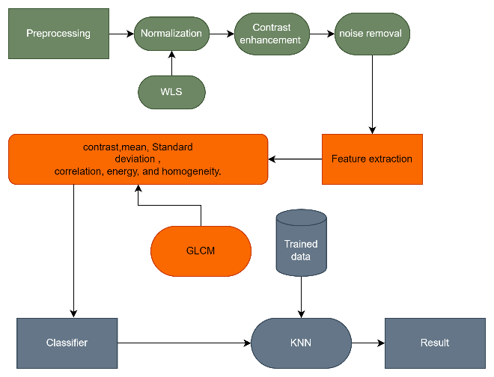
PROJECT OVERVIEW:
KNN BASED:
It is a recognition system applied to the obtained blood microscopic images, then it performs normalization in preprocessing, cell segmentation in segmentation,and size ratio features in feature extraction, and KNN based classification in classification process.

Slide 6
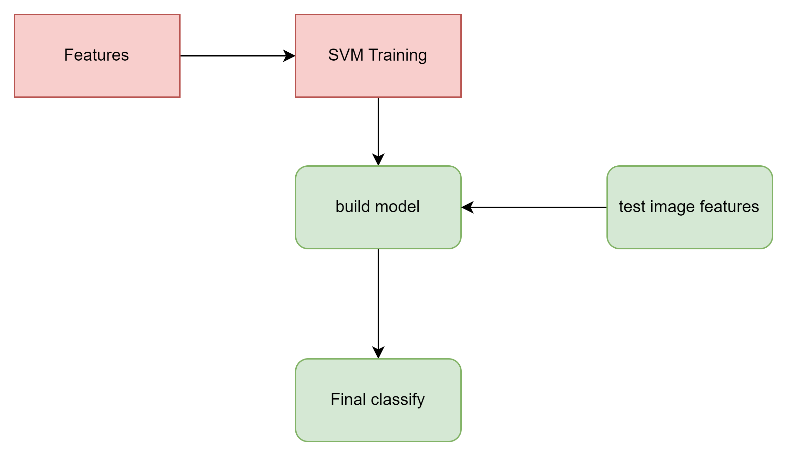
SVM BASED:
In SVM algorithm will use the same feature that extract in the preprocessing stage , with the help of the training image the model will be trained then the test image feature will be given input in the model which will classify the new image.

Slide 7
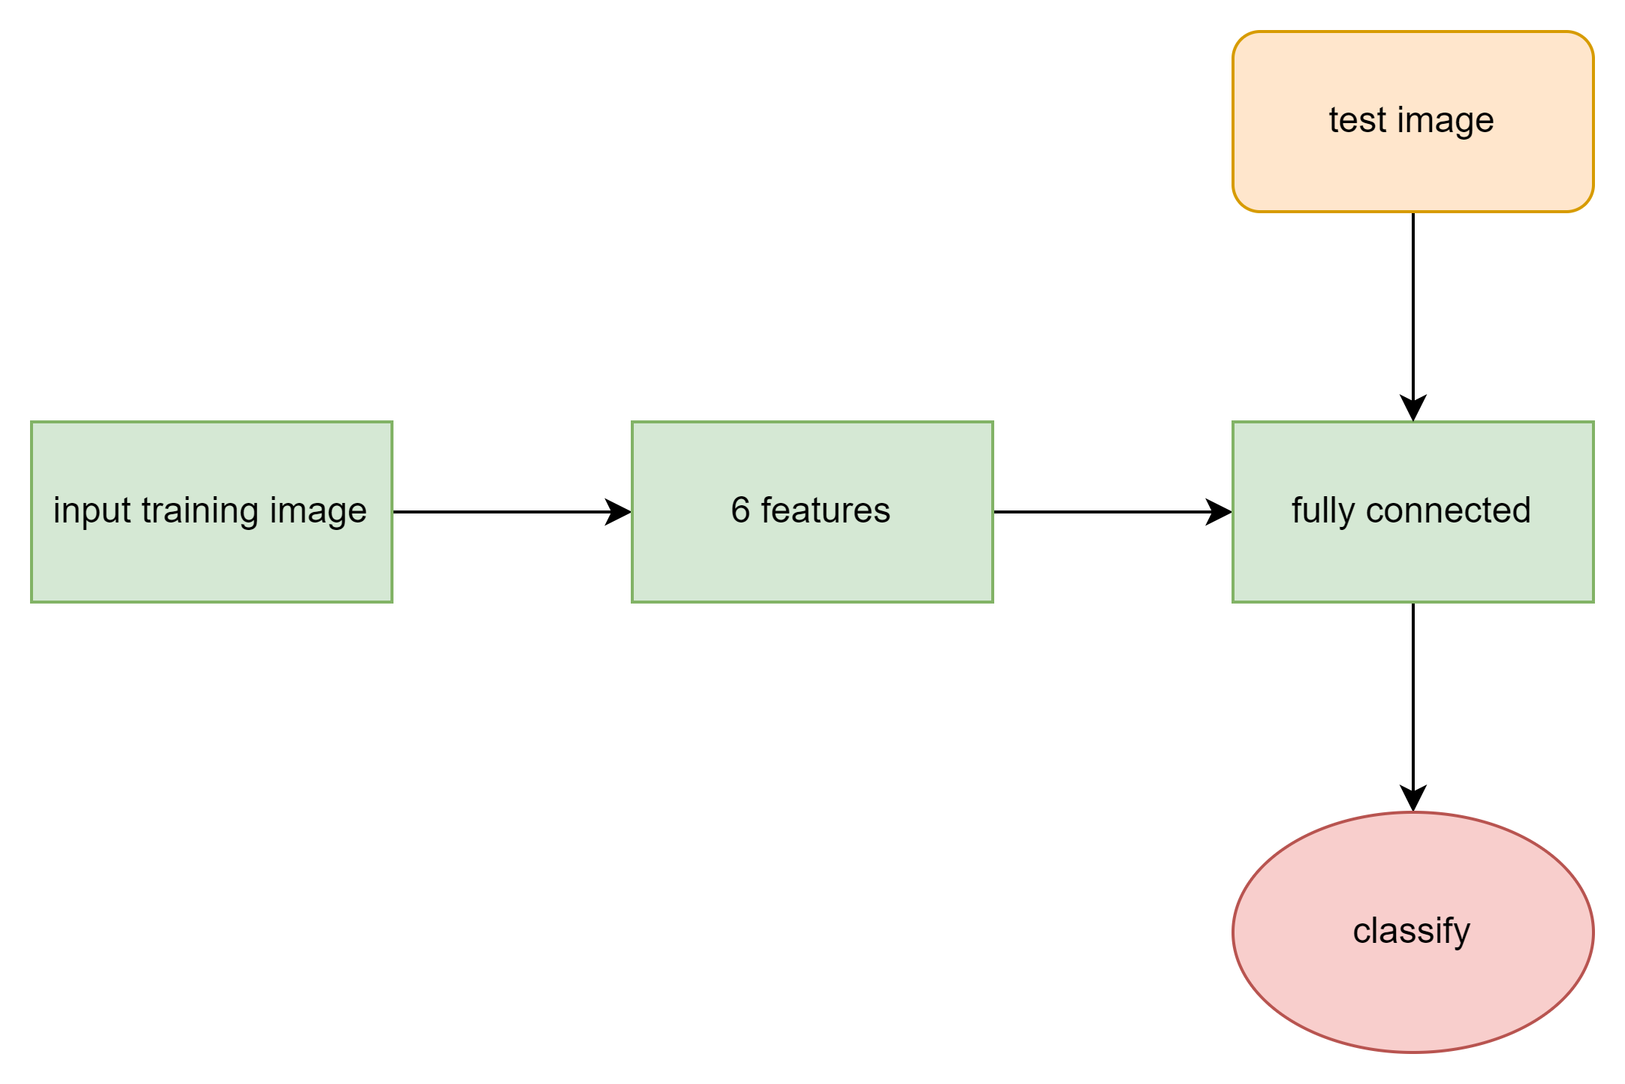
CNN BASED:
In CNN algorithm will use the same feature that is extracted in the preprocessing stage, with the help of the features the model will build the connection mapping layer then the test image feature will be given input in the model the test input feature will be processed in connection mapping layer which will classify the new image.

Slide 8
DATASET USED:
The BCCD (Blood Cell Count and Identification) dataset is a widely used dataset in computer vision and machine learning. It is used to develop and evaluate algorithms for the detection and counting of blood cells in microscopic images. The BCCD dataset contains a total of 2000 images
DATASET | TOTAL IMAGE | TRAINING | TESTING
Blood Cell Cancer Detection Image DataBase (BCCD) | 2000 | 1800 | 200

Slide 9
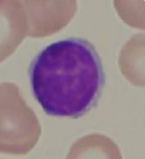
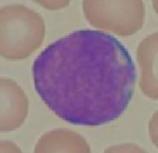
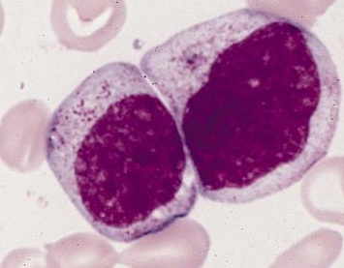
TEST IMAGES:
Normal cell
Leukaemia affect cell
Myeloma affect cell

Slide 10
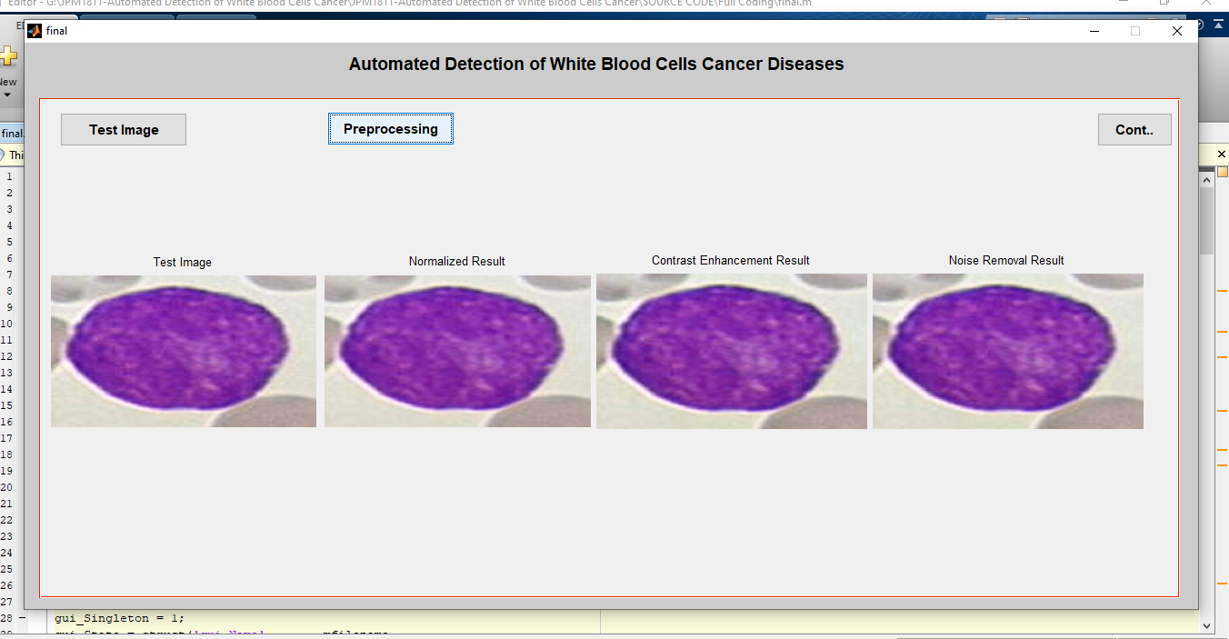
SIMULATION:

Slide 11
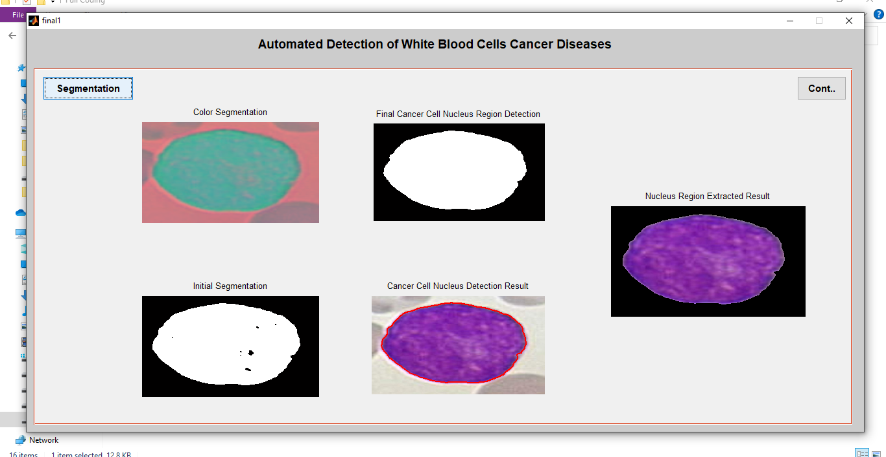
SIMULATION:

Slide 12
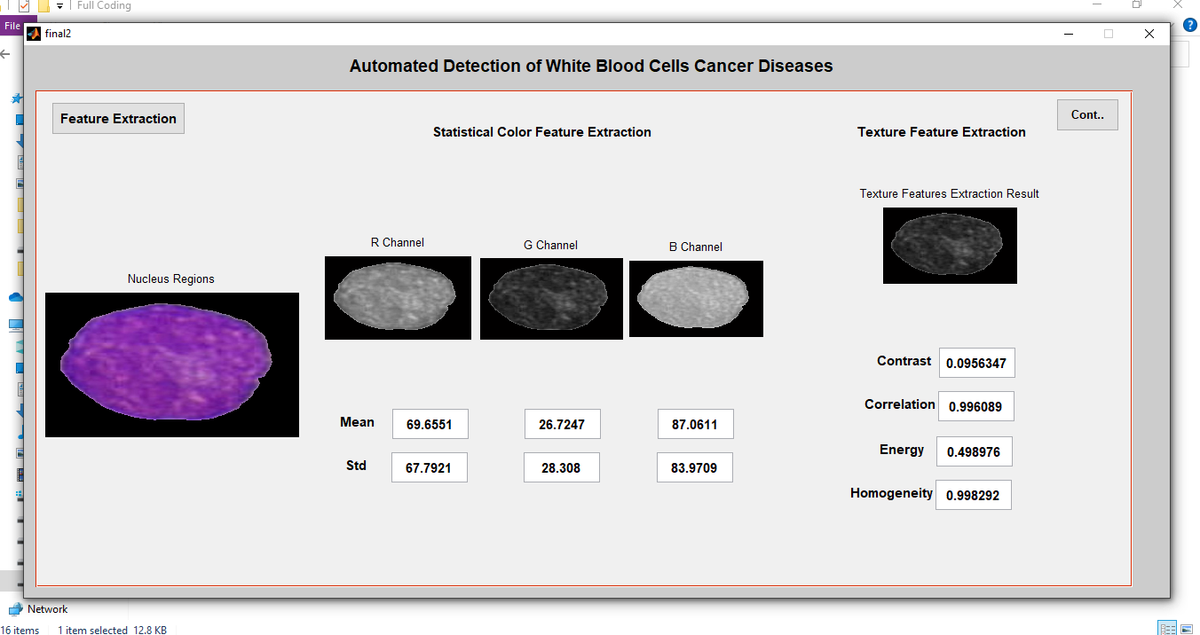
SIMULATION:

Slide 13
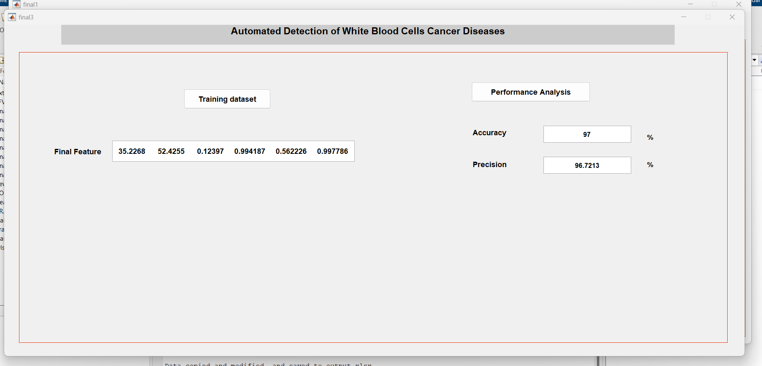
SIMULATION:

Slide 14
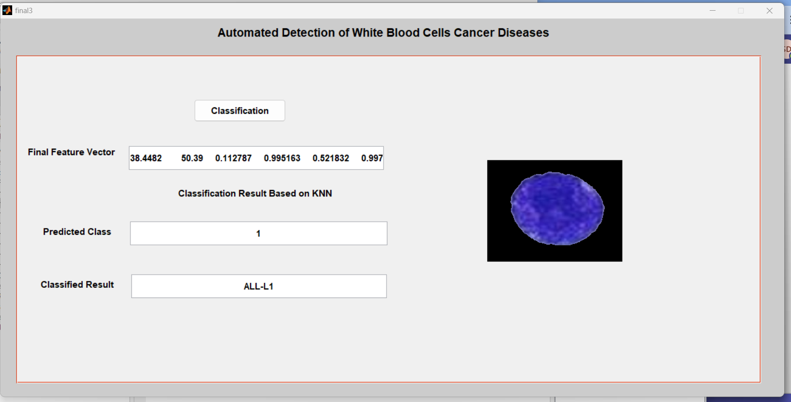
SIMULATION:

Slide 15
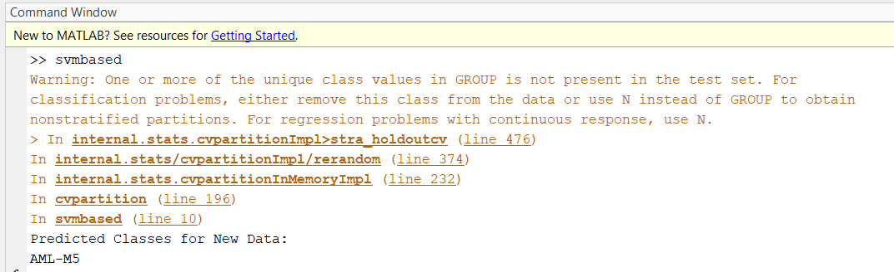
SIMULATION:

Slide 16
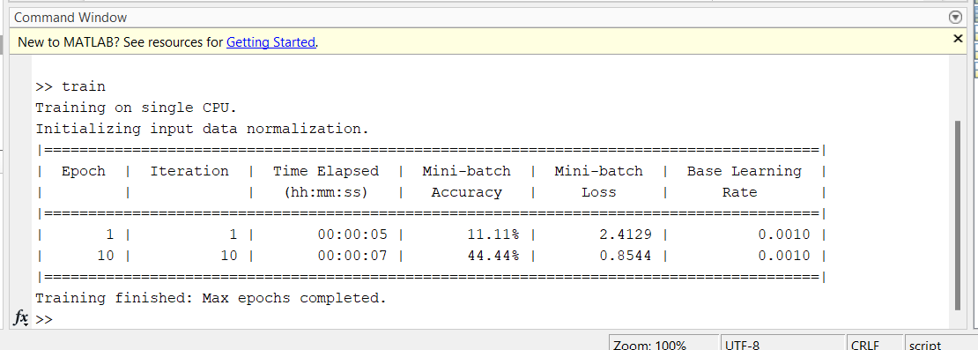
SIMULATION:

Slide 17
RESULT
Through testing and evaluation, our proposed method has demonstrated superior accuracy compared to existing systems. A detailed analysis reveals that the KNN model outperforms other classification models in terms of accuracy during the testing stage and its effectiveness in white blood cell cancer disease detection.
METHODS | TRAINING | TESTING | CORRECT | WRONG
KNN | 450 | 50 | 48 | 2
SVM | 450 | 50 | 43 | 7
RF | 450 | 50 | 41 | 9
CNN | 450 | 50 | 45 | 5

Slide 18
SOCIAL IMPACT
Healthcare System: Early detection of leukemia allows for reducing the burden on healthcare systems by preventing advanced-stage cases.
Quality of Life: Timely detection can improve the quality of life for individuals diagnosed with leukemia by enabling early access to appropriate medical care and support services.

Slide 19
CONCLUSION:
The paper presented a method for detection of white blood cells cancer disease. In that, four steps such as preprocessing, segmentation, feature extraction and classification are followed to detect the disease. KNN, SVM, and CNN algorithm. By using this model, we can identify white blood cell cancer at an early stage. Also, we can avoid problems with the wrong identification process in cancer detection. the learning efficiency of system to learn from the input tests in which classify the disease with the new label.

Slide 20
SCOPE FOR IMPROVEMENT
In the future, we can improve a lot by adding more features. We could make it able to detect more types of white blood cell cancers, not just two types, and then create a complete system that can handle different kinds of white blood cell diseases.

Slide 21
TIME LINE (Jan to May 2024)
The

Slide 22
REFERENCE:
Agaian S, Madhukar M, Chronopoulos AT (2014) Automated screening system for acute myelogenous leukemia detection in blood microscopic images. IEEE Syst J 8:995–1004.
X. Zheng, Y. Wang, G. Wang, and J. Liu, ‘‘Fast and robust segmentation of white blood cell images by self-supervised learning,’’ Micron, vol. 107, pp. 55–71, Apr. 2018.
M. LaFleur-Brooks, Exploring Medical Language: A Student-Directed Approach, 10th ed., D. L. Brooks, Ed. St. Louis, MO, USA: Elsevier, 2018, pp. 757–758.
Loey M, Naman MR, Zayed HH (2020) A survey on blood image diseases detection using deep learning, vol. 11.
Chatap N, Shibu S (2014) Analysis of blood samples for counting leukaemia cells using support vector machine and nearest neighbour. IOSR J Comput Eng (IOSR-JCE) 16(5):79–87.
Naik S, Doyle S, Agner S, Madabhushi A, Feldman M, Tomaszewski J. Automated gland and nuclei segmentation for grading of prostate and breast cancer histopathology. In: 5th IEEE international symposium on biomedical imaging: from nano to macro, 2008. ISBI 2008. IEEE; 2008. p. 284–87.

Slide 23
THANK YOU

